Slide 1
Pseudohomophones
Building the experiment in PsychoPy

Slide 2
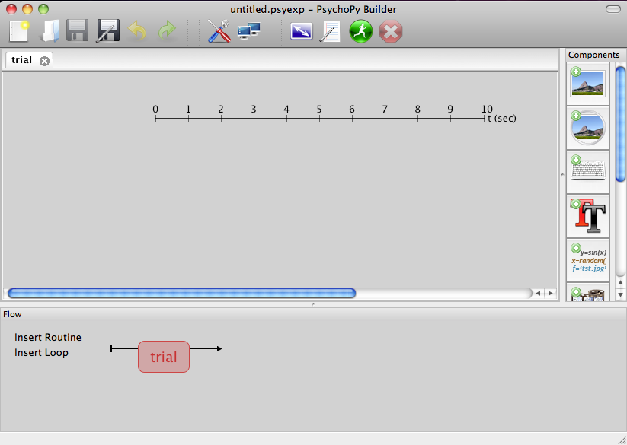


Getting started in PsychoPy
Open PsychoPy and go to the Builder view
If you have an experiment already open create a new one
Save it straight away to your pseudohomophones folder next to the 3 Excel files (practiceA.xlsx, practiceB.xlsx, trials.xlsx)

Slide 3

Setting the experiment properties
In the dialog, one of the settings says ‘Experiment Info’ and another says ‘Show info dlg’
This allows us to present a dialog to subjects and control what gets stored
Let’s add boxes to ask for the subject age and gender, useful for writing the methods section
Set Experiment info to read;
{'participant':' ', 'session':'005', 'gender':' ', 'age':' '}
Make sure your inverted comma’s match up!
Hit OK to close the dialog

Slide 4
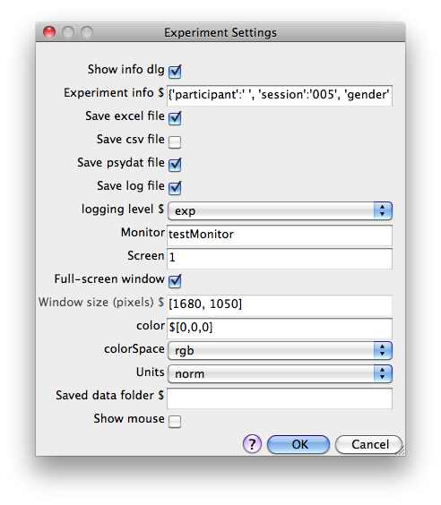

Slide 5
Conditions files
You should have been told by now which group you’re in (A or B). Open up the practice conditions for your group e.g. trainingA.xlsx
It’s important that you are only exposed to the training stimuli for your group, so don’t open the other group sheet yet.
Notice there are 4 different columns for the
upperWord
lowerWord
corrAns (is the real word upper or lower?)
wordType (is the real word just a word or also a homophone?)

Slide 6
Define one trial
We need to set up a trial with;
a fixation (we could use a ‘+’) for 4s
a word that appears above fixation for 3s
a word that appears below fixation for 3s
a response from the participant, that will terminate the trial

Slide 7

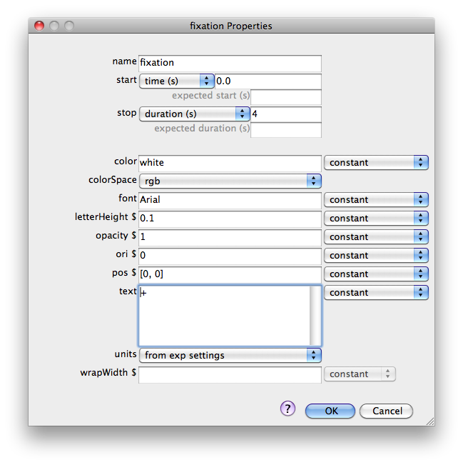
Create the fixation
Add a text component
Set it to start at t = 0 (s)
Duration = 4.0 (s)
Text = +

Slide 8
Units in PsychoPy
PsychoPy can present your stimulus in different locations/sizes
The ‘units’ of the coordinates can vary (can use pixels, or degrees of visual angle…)
By default, the units are ‘norm’ for normalised
(-1,+1)
(+1,+1)
H = 2
(-1,-1)
(+1,-1)
W = 2

Slide 9
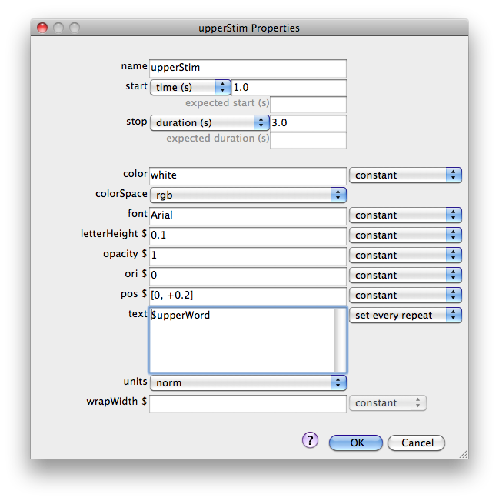
Create the upper word
Name = upperStim
Set to start at t = 1.0 (s)
Duration = 0.5 s (=500ms)
Pos = [0, +0.2]
Text = $upperWord
(this will come from our conditions file in Excel)

Slide 10
Create the lower word
Repeat as for upperStim, but set pos to be
pos = [0,-0.2] i.e. 10th of screen below the fixation point
name = lowerStim
text = $lowerWord (parameter from the conditions file)
Remember to set the text value to change every repeat (otherwise you’ll get an error message)

Slide 11
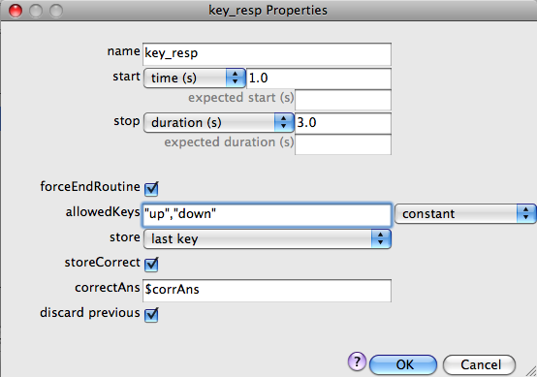
Collect a response
Now we need a Keyboard Component to collect the participant’s response
Start at the same time as the words and last for 3s
Must match the name of the param in Conditions file

Slide 12
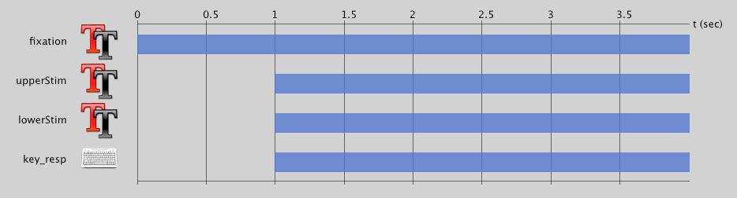
Trial overview
Your trial Routine should now look like this:

Slide 13
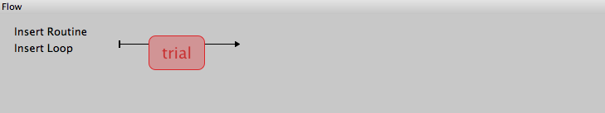
Setup the experiment Flow
Initially the Flow probably looks like this:
We want to have a set of trials for training, followed by some (identical) trials for testing

Slide 14



Add a loop for the training trials
Press Add Loop (single-click)
Select the start and endpoints for the loop (single-click each one)

Slide 15
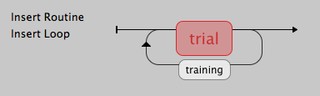
Add your conditions to the loop
Set your number of trials (1 repeat?) and select the file for the conditions (training A or training B, according to your group)
If the loop looks wrong (e.g. in the wrong place) press Undo (or press Ctrl-Z) and repeat the steps. Remember to single-click the buttons

Slide 16
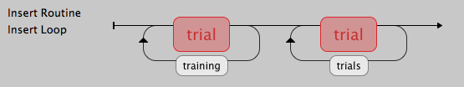
Add main trials
Add another copy of the ‘trial’ Routine at the end of the Flow
Add another loop around it, called trials (or main ?)
use the conditions file ‘testing.xlsx’
nReps = 1
It should look like this:

Slide 17
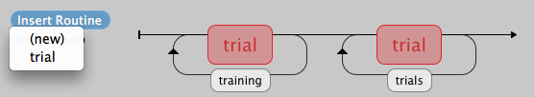
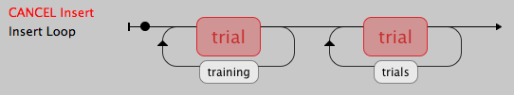
Add some instructions
Press Insert Routine and select (new)
Give your Routine a unique name (‘instr’ ? ) and click where you want it on the Flow

Slide 18
Add some instructions
In your new Routine add a Text Component (called instrText ?) with something like this:
Press ‘up’ or ‘down’ keys to identify the stimulus that is a real word
Press any key to continue
Your Text Component should last forever (end time is blank)
Add a Keyboard Component so that you can end the instructions:
ForceEndRoutine should be ticked
allowedKeys should be blank (any key)

Slide 19
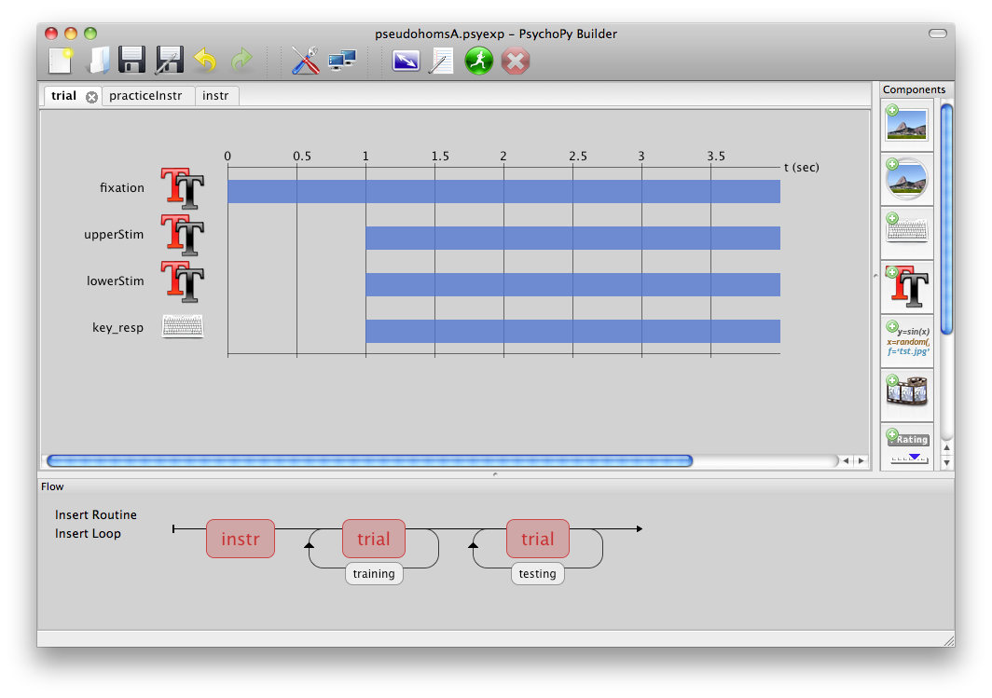
That’s it!

Slide 20
Take a break
We’ll run the study afterwards

